Slide 1
peacebuildR:
Using R for World Peace
Talia Hagerty, Senior Research Fellow,
Institute for Economics & Peace

Slide 2
Institute for Economics & Peace
Access, clean, index datasets & visualize results in R
Measure (negative) peace: designing and building indices → a single score for a complex concept
R + APIs -> DB of 25k+ econ indicators & correlates of peace
Understand (positive) peace: the consistent characteristics of peaceful societies
From linear models to systems analysis, and everything in between
Model and measuring the risk of breakdowns in peacefulness
Quantify the economic value of peace
Data driven insights for a more peaceful and prosperous world

Slide 3
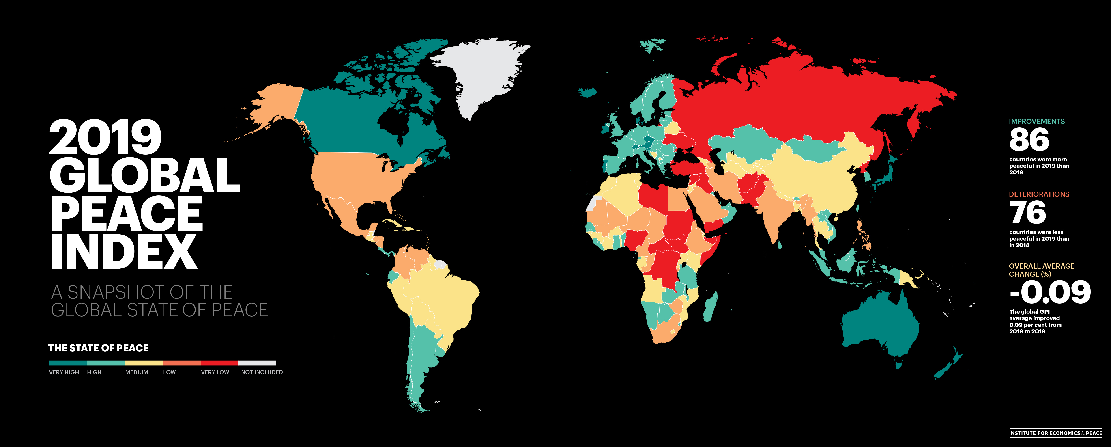

Slide 4


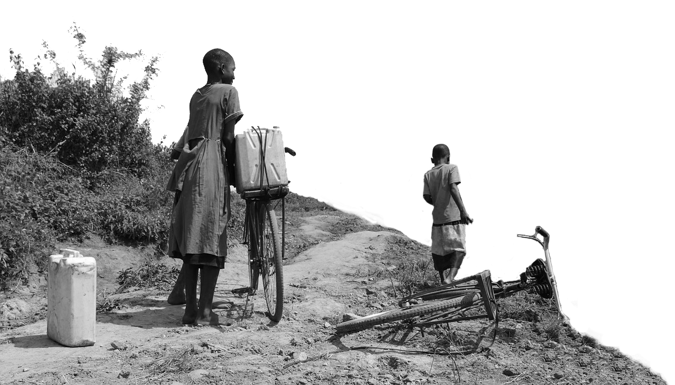
2019 highlights
The average level of country peacefilness has improved by
from last year.
86
countries became more peaceful,
0.09%
76
deteriorated.
This was the first improvement in the last five years.
Deteriorations primarily driven by changes in:
Perceptions of Criminality
Internal and External Conflicts Fought
Incarceration
Improvements were driven by changes in:
Deaths from Internal Conflict
Military Expenditure

Slide 5


The global cost of violence, 2019
Deaths from conflict and terrorism peaked in 2014.
$14.1
trillion
Which is equivalent to
11.2%
of total world GDP
OR
$1853
per person
If the world decreased
violence by 10%...
$1.41 TRILLION
Could be directed to
other economic activities

Slide 6
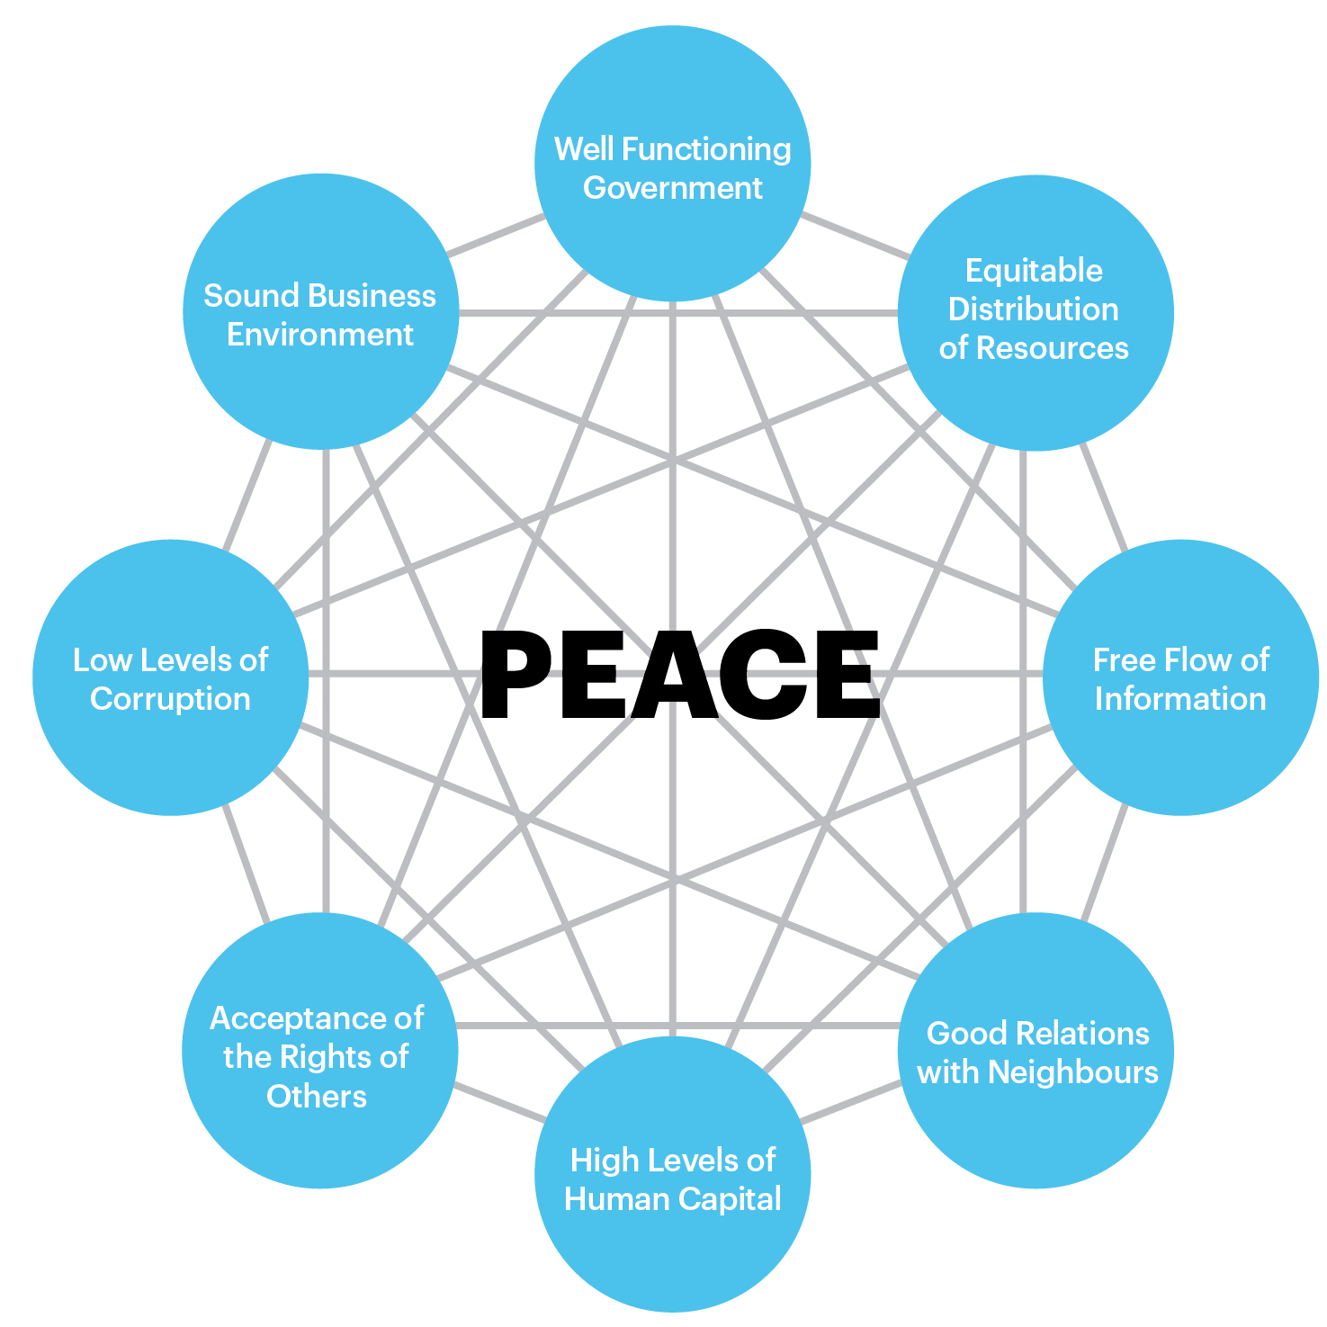

Positive Peace
The inverse of violence is not the same as the presence of peace
Empirically derived by correlating over 10k relevant indicators
Framework is broadly consistent with the literature
Yields new datasets for understanding peacefulness
But yields some surprising findings that we could not previously model…

Slide 7
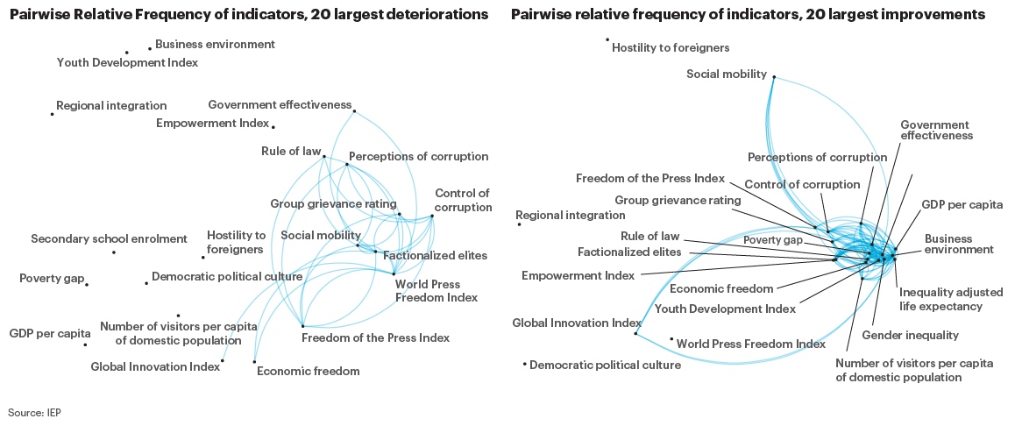
Positive Peace
The inverse of violence is not the same as the presence of peace

Slide 8
From programming to policy….

Slide 9
#peacebuildRgoalz
Scale up our interactive websites for different language users
Develop the go-to World Violence Database
And the peacebuildR package for using it
Predict drug war escalations with 80%+ accuracy

Slide 10
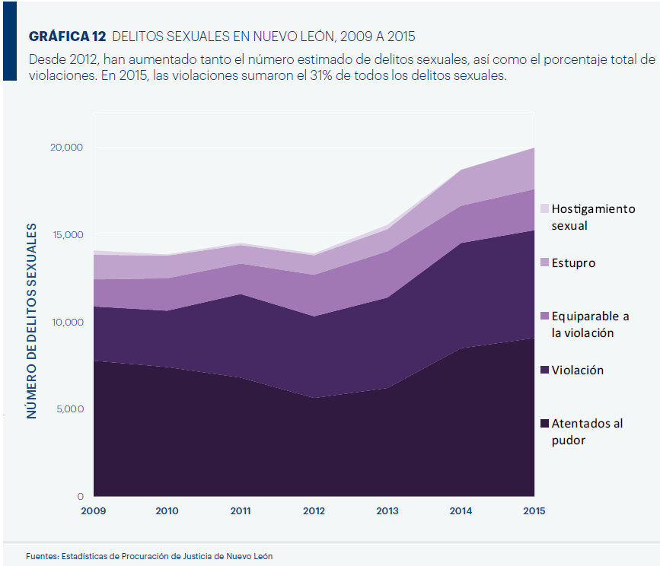
#peacebuildRgoalz
Sexual assault by type, Nuevo Leon, Mexico
The toughest chart I’ve ever made!
And probably the most impactful

